Slide 1

Shopee BI Report
Billy Truong
Jan 7th, 2024

Slide 2
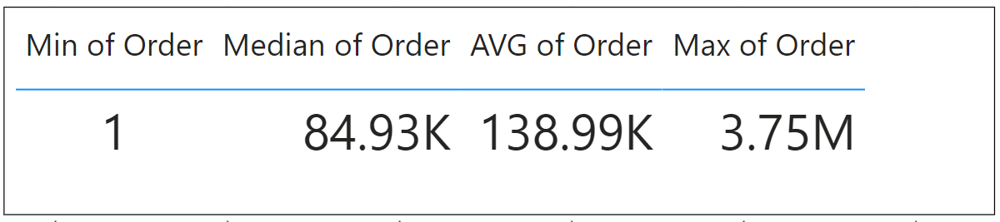
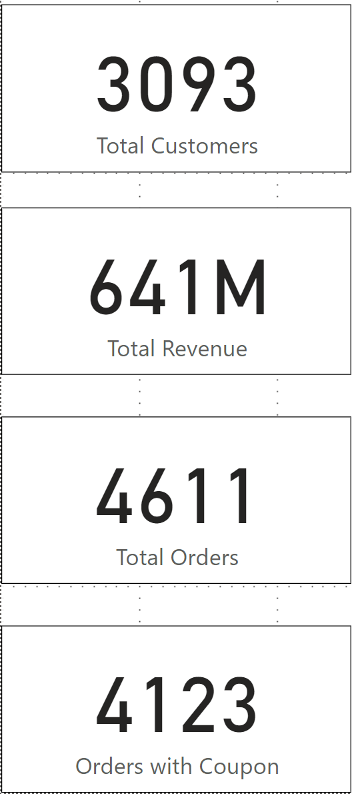
Overview
By average, every customer has 1.5 orders.
89.41% Orders used coupon.
641M VND in total Revenue in 4 days (Oct 30th – Nov 2nd).

Slide 3
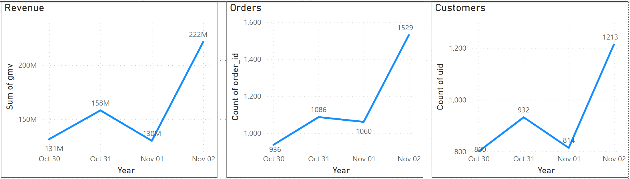
Revenue
By average, every customer has 1.5 orders.
Nov 2nd has significantly higher Revenue and Orders.
Fraudulent could happen.

Slide 4
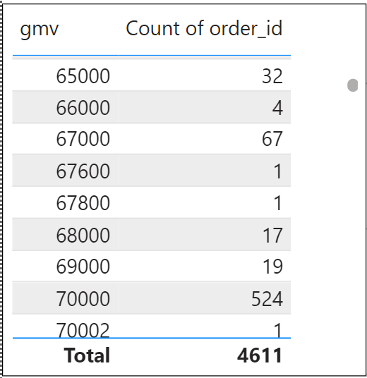
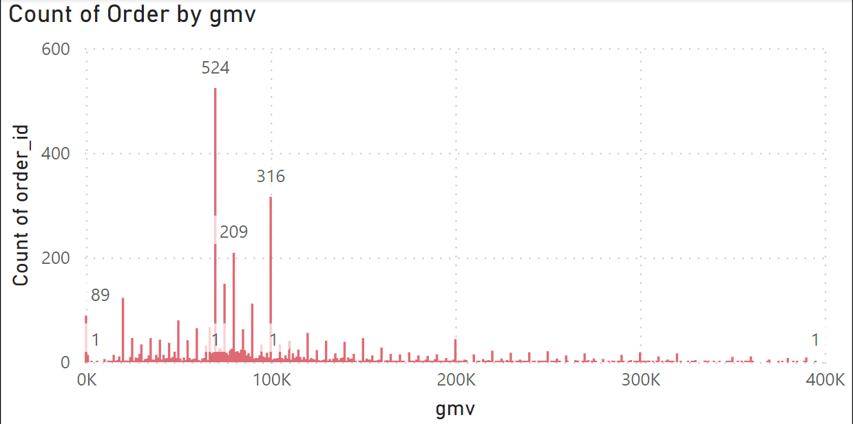
Order Value Range
Order Value Range from 65,000 VND – 70,000 VND is the most, 665/ 4611 Orders (14% total Orders)
Because the Rebate is 30% and Maximum 20,000 VND so Order Value from 65,000 – 70,000 VND will maximum the Rebate for Customers.

Slide 5
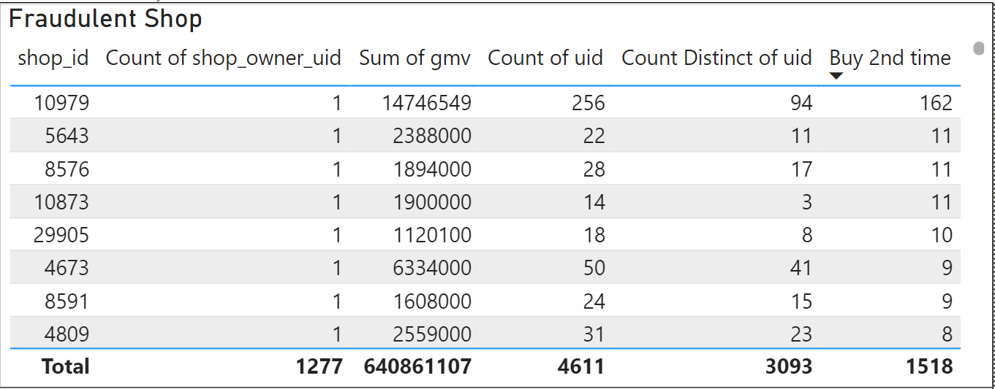





Fraudulent Detection
Every Shop_owner_uid is assigned to only 1 Shop_id.
TOP 5 Shop_ids are suspected to fraudulent: 10979, 5643, 8576, 10873, and 29905
10979: 256 Orders from 94 Distinct Customers, 162 Customers order more than 1 time.
Same logic apply for Shop_id 5643, 8576, 10873, and 29905

Slide 6
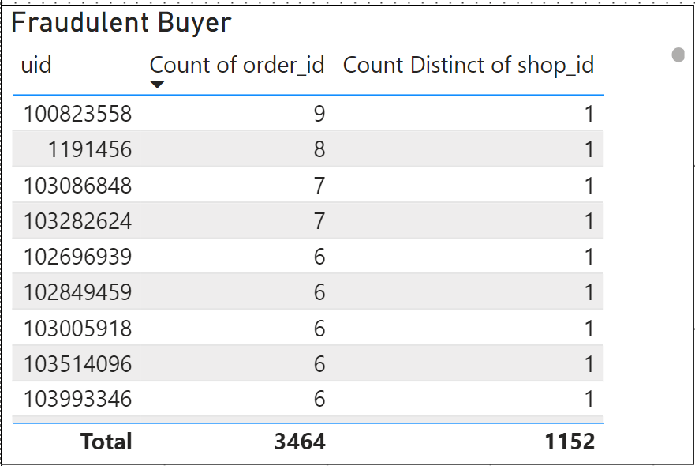





Fraudulent Detection
TOP 5 User_ids are suspected to fraudulent: 1191456, 103086848, 103282624, 100823558, and 103993346
1191456: 9 Orders from the same Shop
Same logic apply for User_id 103086848, 103282624, 100823558, and 103993346

Slide 7
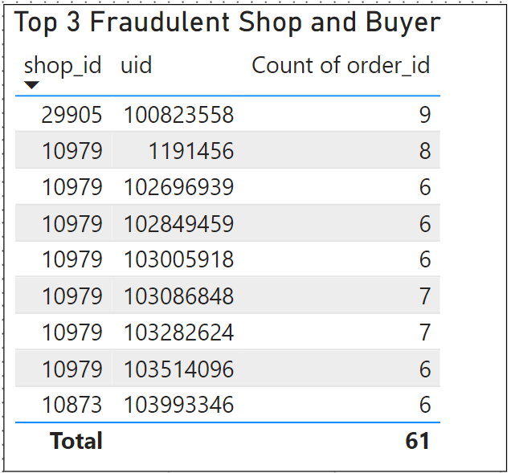


Top 3 Fradulent Shop and Buyer
After matching the results, we have conclusion Top 3 shops and Buyers are fraudulent:
Shop_id & Uid:
29905 & 100823558
10979 & 1191456
10873 & 103993346

